Slide 1


Slide 2
UNDERSTANDING AND AVOIDING PENALTY POINTS

Slide 3
WHAT ARE PENALTY POINTS?
Points deducted from a written report because the report did not follow the criteria established on the Penalty Point Checklist.

Slide 4
PENALTY POINT CHECKLIST
Page 54 in the 2019-2020 DECA Guide
Ensures fairness
Maintains a level/equal playing field for all competitors
Allows for consistent evaluation by judges

Slide 5
1. The Written Event Statement of Assurances and Academic Integrity must be signed and submitted with the entry.
15 POINTS PENALTY
Page 55 in the 2019-2020 DECA Guide
Must be signed by advisor and ALL participants
Hole punch and place in front of the folio
Notes:
This statement is designed to ensure that only original work is submitted into competition. Students must cite their sources and give appropriate credit to authors.

Slide 6



2. Entries must be submitted in an official DECA written event folio.
5 POINTS PENALTY
Place the entire written report, Statement of Assurances, title page, table of contents, appendix, etc. in a folio.
Available from Shop DECA

Slide 7
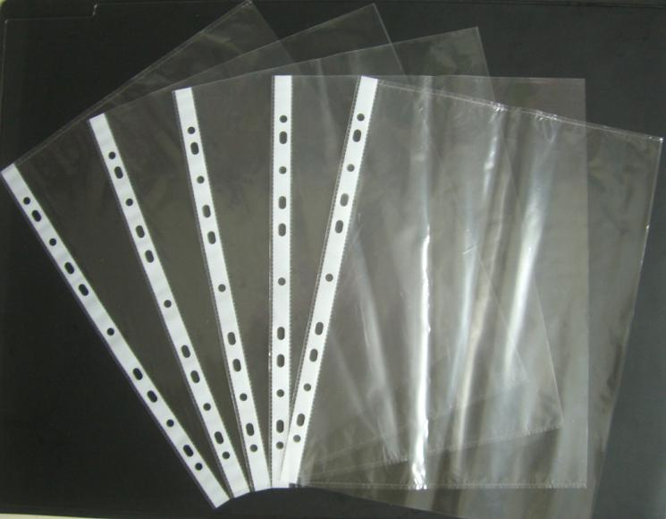
3. Sheet protectors may not be used.
5 POINTS PENALTY
Do not place pages from written entry in sheet protectors.

Slide 8
4. Limited to the number of pages specified in the guidelines (plus title page and table of contents).
5 POINTS PENALTY PER PAGE
10 pages max for EIP, ESB, IMCE, IMCP, IMCS, SMG
20 pages max for BOR, BMOR, FOR, HTOR, SEOR, PMBS, PMCD, PMCA, PMCG, PMFL, PMSP, EFB, EIB, EBG, and IBP.
Entire entry may be single-spaced. It can also be double-spaced, but that is no longer a requirement.
Notes:
Page limits are in place to aid in the review process. Judges do not have time to read 50 and 60 page reports. Page limits require students to be concise and state the most important information in their writing.

Slide 9
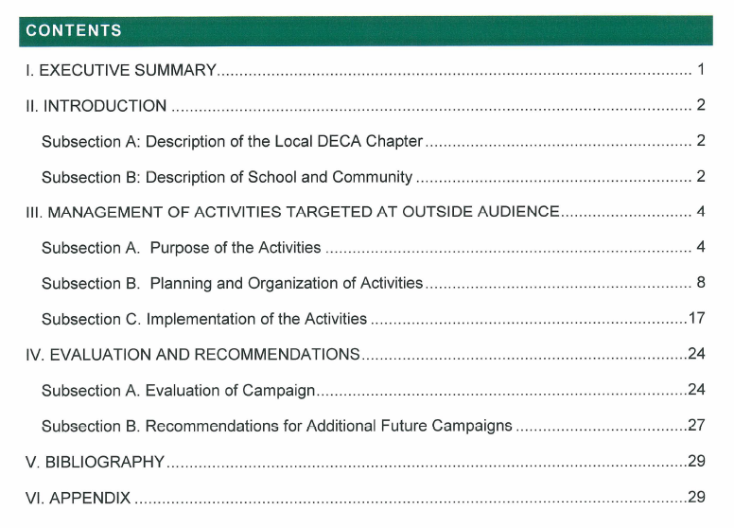
5. All pages are numbered in sequence starting with the executive summary and ending with the final page of the appendix.
5 POINTS PENALTY
The Title Page and the Table of Contents should not be numbered
The Executive Summary should be page 1
Ensure graphics don’t cover page numbers
Notes:
Again, this rule is in place to aid in the review of written entries. The more uniform entries are in structure, the easier it is for the judge to find information and evaluate each section.

Slide 10
6. Entry must be typed. Handwritten corrections, notes, charts and graphs will be penalized.
5 POINTS PENALTY
No handwritten corrections
Charts and graphs must be typed
No handwritten page numbers
Don’t submit the exact copy from state/provincial conference – it may have comments from judges written on it.
Notes:
This rule is in place to reinforce the importance of submitting professional-quality work.

Slide 11
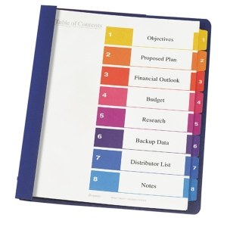
7. Paper is 8 ½ inches by 11 inches. No fold-outs, attachments, tabs used.
5 POINTS PENALTY
Nothing should extend past the dimensions of the paper
Notes:
This rule is in place to assist DECA with handling entries at ICDC. Thousands of written projects are submitted at ICDC and they must be transported and stored in boxes. Uniform sizing helps with these issues.

Slide 12
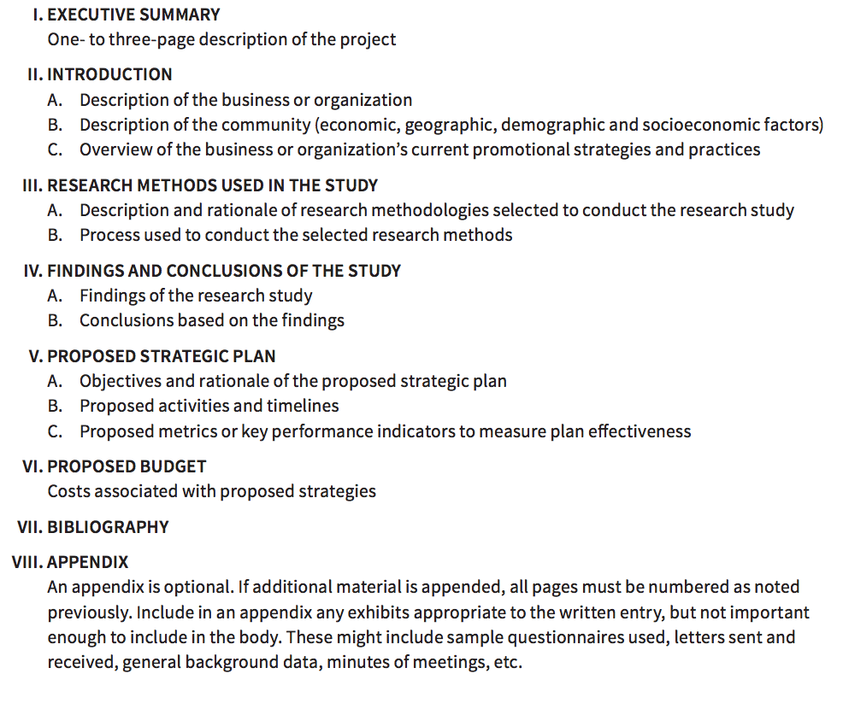
8. The written entry follows the format guidelines.
5 POINTS PENALTY
Be sure to use this year’s guidelines
Each section should be addressed and titled
Additional subsections are permitted

Slide 13
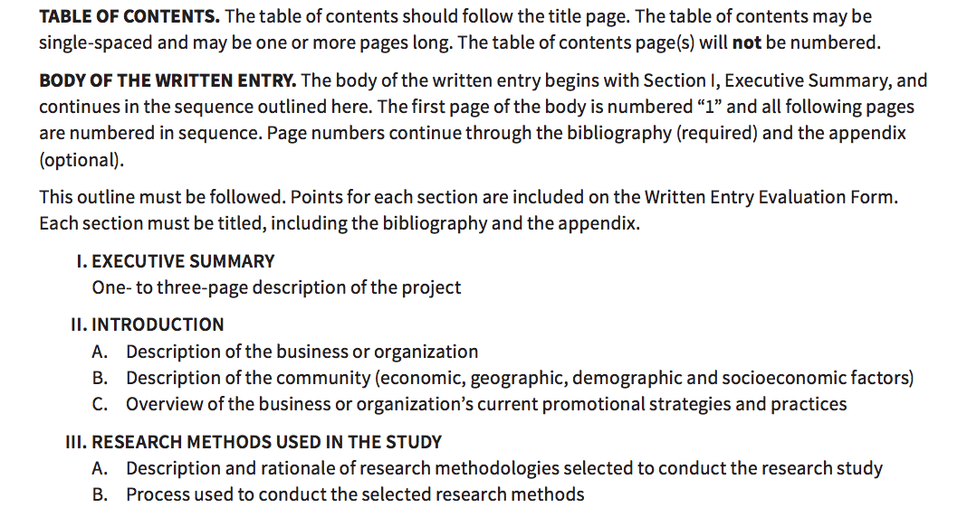
8. Continued
At ICDC, the Table of Contents and the Title Page will not be penalty pointed for format.
Reviews will begin on page 1, the Executive Summary.

Slide 14
9. Written entry must be printed single-sided.
Only use the front side of a sheet of paper.
Do not print on the back side of the sheet of paper.

Slide 15
COMMON REASONS FOR
PENALTY POINTS
Not using the current year’s event guidelines
  Guidelines change from year to year
All participants or advisor not signing the Statement of Assurances
Leaving out sections in the body of the written entry
Too many pages

